Slide 1
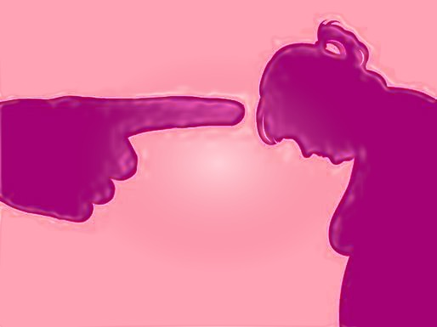
Emily R. Squyres
lore m. dickey
Louisiana Tech University
When Thin Still Isn’t Good Enough: Residual Obesity Stigma & Psychological Flexibility

Slide 2
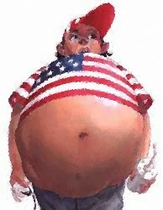
Notes:
Obesity rates have been rising worldwide
They are highest in the US
Adult obesity has doubled since the 1980’s and child obesity has tripled.
Presently we have ~ 36% of the adult population and ~17% of children battling obesity
64% of US adults are overweight or obese,

Slide 3
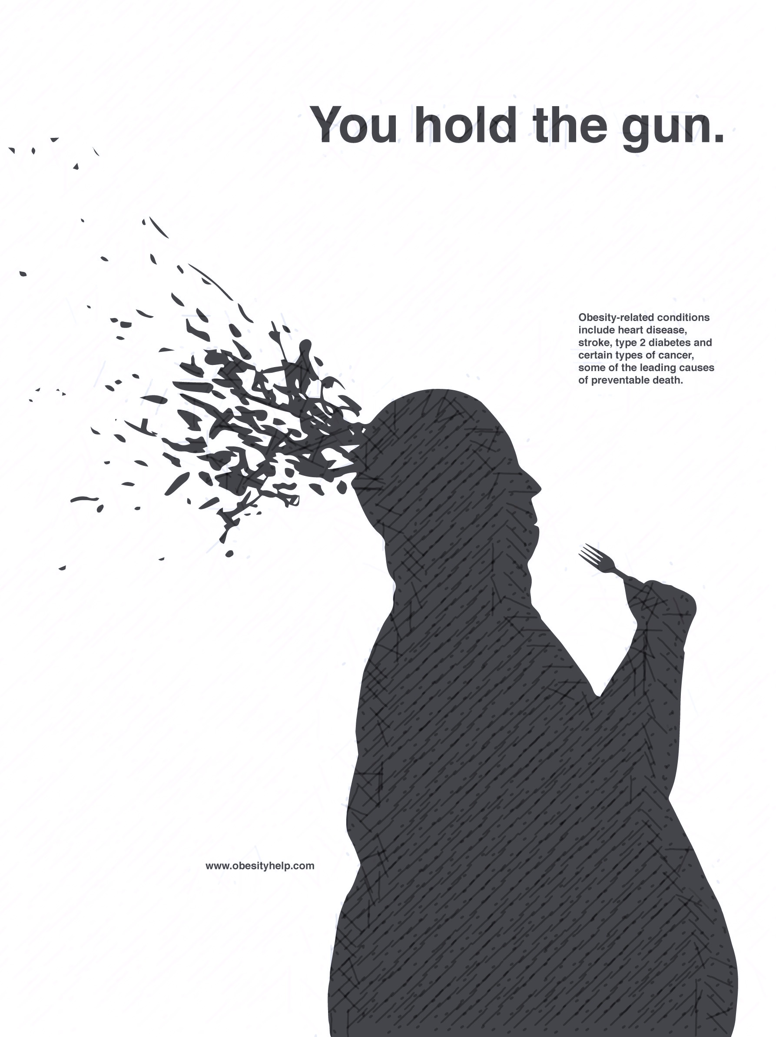
Notes:
Consequences:
Physical: heart disease, diabetes, increased risk of cancer
As of 6/11/16 in the U.S. this year 136,960 people have died from obesity related issues
Psychological: comorbid with mood disorders, mania, agoraphobia without panic disorder, addictive disorders, binge eating, decreased quality of life
LEADS INTO SOCIAL CONSEQUENCES!

Slide 4
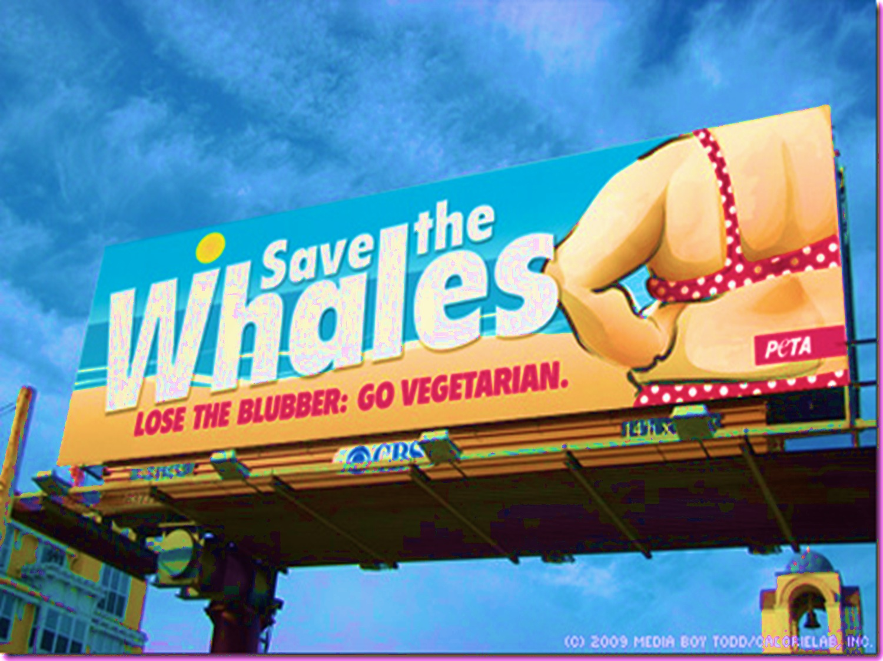
Notes:
STIGMA & STEREOTYPES
Disordered eating issues are pretty common among the obese. Unfortunately so are stigmatizing experiences.
Irving Goffman defined stigma as “being an attribute that is deeply discrediting” saying that the result of the stigma is that it reduces the stigmatized “from a whole and usual person to a tainted, discounted one”
Common Stereotypes of obese: as lazy, self-indulgent, unattractive, bad, and worthless
At the root of these stereotypes is the ongoing public perception that obesity is EASILY within the individual’s control.
So, this boils down to not only are the obese lazy, self-indulgent, unattractive, bad, and worthless, but they are to blame.
This is even the case with formerly obese folks because they are still treated as if they are obese…not as severely but enough that it seems one can never get rid of the stigma, even if you lose weight.
Obese folks get promoted at work less and make less money than average weight people.

Slide 5
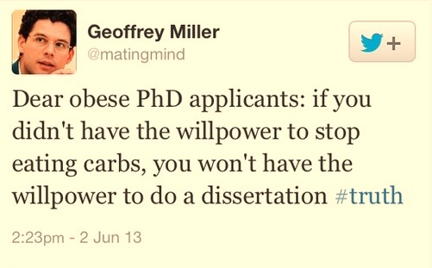

Slide 6
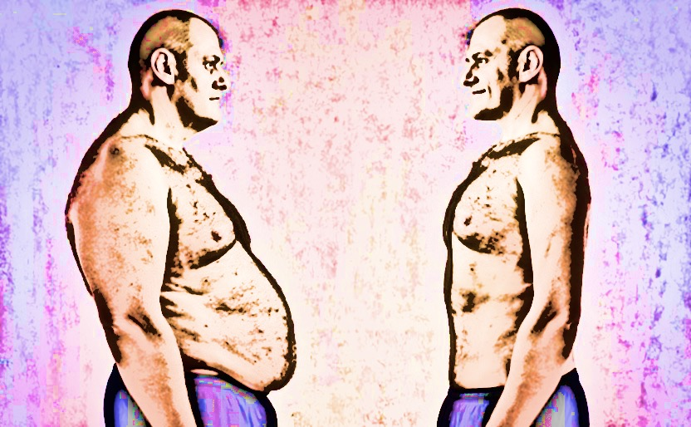
Notes:
RESIDUAL OBESITY STIGMA
Original study done my Janet D. Latner, Daria S. Ebneter, & Kerry S. O’Brien (University of Hawaii at Manoa)
Found that currently lean individuals with a history of obesity were judged as less attractive than lean individuals who had never been obese.
This was the case regardless of whether the person lost weight through diet and exercise or through bariatric surgery
Consistent with long-term studies showing lower earnings and occupational attainment of women who were previously overweight.
This is was the starting place for the current study:
Could I reproduce the results?
What about psychological flexibility?
Would being able to see a representation of the individual change the bias?

Slide 7
MEASURES IN STUDY

Slide 9
Weight variable: Currently average sized with a history of weight issues
Shelley is a 31 year-old Caucasian female who is currently working as a nurse in a doctor’s office. Throughout her life, Shelley was always overweight. Shelley reached her current height of 5 feet and 7 inches around 16 years of age. For the majority of her life she weighed 205 pounds. However, Shelley was able to lose a large amount of weight recently, and is no longer overweight. Therefore, Shelley is now 5’7” tall and weighs 135 pounds.
Notes:
AND THE RESULTS ARE….

Slide 10
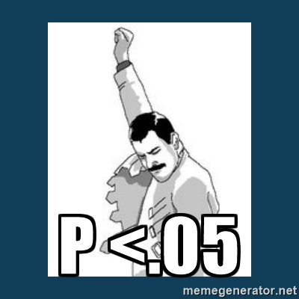
Notes:
Nothing significant

Slide 11
BMI
1- Underweight
2- Average
3- Overweight
4- Obese
Vignette:
A: Obese
B: Average
C: Average/Obese
D: Underweight/Obese
Notes:
Underweight- high inflexibility for obese
More flexibile for average weight people who used to be obese
Almost as much inflexibility for currently underweight individuals who used to be obese as those who are and always were obese.
Obese individuals are more inflexible than overweight individuals or healthy individuals
Healthy weight individuals are much more flexibile across all conditions overall

Slide 12
BMI
1- Underweight
2- Average
3- Overweight
4- Obese
Vignette:
A: Obese
B: Average
C: Average/Obese
D: Underweight/Obese
Notes:
LOWER SCORES= MORE NEGATIVE JUDGMENT
UNDERWEIGHT
More negative judgment for obese
Higher for avg/obese but lower than that for underweight/obese

Slide 13
BMI
1- Underweight
2- Average
3- Overweight
4- Obese
Vignette:
A: Obese
B: Average
C: Average/Obese
D: Underweight/Obese
Notes:
HIGHER SCORES INDICATES PREFERRED GREATER SOCIAL DISTANCE
UNDERWEIGHT
Prefers most distance between avg/obese than obese/obese
Prefers more distance between underweight/obese than obese/obese
OBESE
Prefers more distance between themselves and other obese individuals than any other BMI category
Explained by social identity theory
Prefer most distance between themselves and underweight/obese

Slide 14
BMI
1- Underweight
2- Average
3- Overweight
4- Obese
Vignette:
A: Obese
B: Average
C: Average/Obese
D: Underweight/Obese
Notes:
HIGHER SCORES = BELIEFS ENDORSING LESS CONCERN OVER EQUAL RIGHTS
UNDERWEIGHT
Shows less concern for equal rights with average/obese than any other BMI group
OBESE
Show less concern for equal rights of healthy individuals

Slide 15
BMI
1- Underweight
2- Average
3- Overweight
4- Obese
Vignette:
A: Obese
B: Average
C: Average/Obese
D: Underweight/Obese
Notes:
HIGHER SCORES = MORE DISLIKE DUE TO FAT BIAS
Obese and Underweight shoe greatest dislike of average/obese
Underweight show almost equal dislike for average/obese and thin/obese

Slide 16
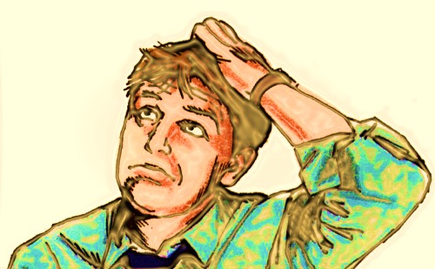
What happened?
Notes:
There are a few reasons why we were unable to reproduce the original study:
The original study was conducted in Hawaii with a completely different population from this one
Race
Original: 41.4% Asian Americans, 20.9% White, 1.5% Pacific Islander, 1.1% Hispanic, .7% African American, 33.3% mixed race
This study: 1.7% Asian Americans, 72.2% white, 3.2% Hispanic, 18.9% African American
BMI
Original: 11% underweight, 60.2% average, 21.2 overweight, 7.1% obese
This study: 3.7% underweight, 48.7% average, 25.3% overweight, 19% obese

Slide 17
Notes:
We had some problems with the AFAQ so running this study again is definitely a possibility
I’d like to run it with different populations though North LA doesn’t afford much diversity
Possibility to run it in Italy
Very much interested in moving into an intervention domain to help overweight and obese individuals cope with stigma and increase quality of life

Slide 18
Thank you so much!
Emily Squyres
ers019@latech.edu
GO DAWGS!

